Slide 1
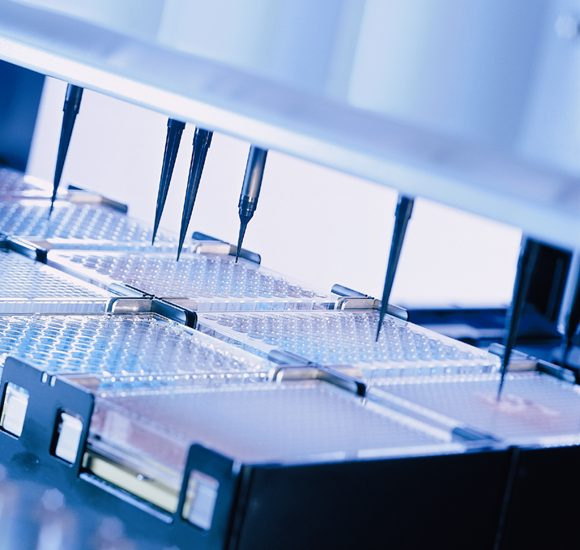
HAMILTON MICROLAB® STAR
Measuring Container Volumes

Slide 2
HAMILTON MICROLAB® STAR
Vector allows you to use a tip to measure the volume within a container.
Why would you do this?
Troubleshoot false “Insufficient liquid” errors
Verify you have enough of a particular fluid before starting a pipetting routine
Verify an amount has been pipetted out of a container (i.e., check the volume before and after pipetting)
Check the accuracy of your container definition

Slide 3
HAMILTON MICROLAB® STAR
There are three commands available to determine the liquid level in a container:
GetLastLiquidLevel
  from the ML_STAR command set
MeasureContainerVolume
  from the HSLML_STARLib library
GetContainerVolume
  from the HSLML_STARLib library

Slide 4
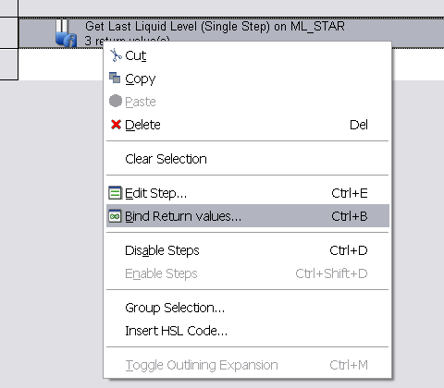
Get Last Liquid Level
The GetLastLiquidLevel command returns the height of the liquid level detected during the previous aspirate or dispense step that used LLD.
To get this piece of data,
Right-click on the command and select Bind Return Values.

Slide 5
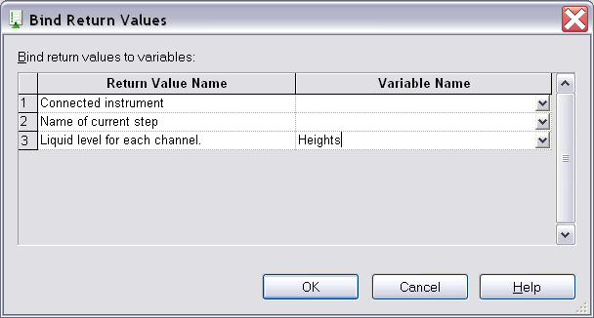
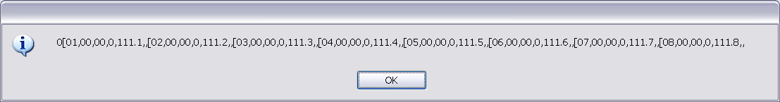
Get Last Liquid Level
Assign a variable to the value number 3.
To test, use a User Output with this variable. The result is like this:

Slide 6
Get Last Liquid Level
You then need to use the String library to parse out the heights (111.1, 111.2, 111.3, etc.)

Slide 7
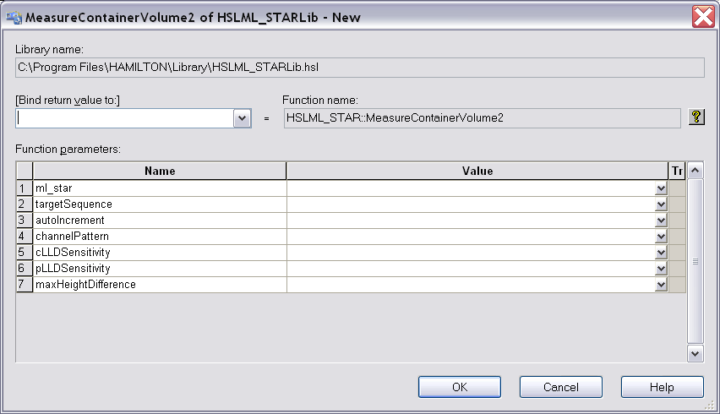
Measure Container Volume
Bring the HSLML_STARLib into your method.
A Tip Pickup command must already be in the method.
Use the MeasureContainerVolume2 command to have the instrument use LLD to detect the liquid surface.

Slide 8
Measure Container Volume
Use these values:
ml_star:
  Pick ML_STAR from the drop-down list.
TargetSequence:
  Pick from the drop-down the sequence that has the liquid you want to measure.
autoIncrement:
  Type 1, if you plan to use this in a loop and want to march through your sequence.
channelPattern:
  In quotes, put in your channel pattern of 1s and 0s, like "11111111".

Slide 9
Measure Container Volume
Use these values:
cLLDSensitivity:
  See the Help (click on the "?" button) for values.
pLLDSensitivity:
  See the Help for values.
MaxHeightDifference:
  If you select to have both cLLD and pLLD on (values > 0 above), then you must select a mm value for Max Height Difference.
  Note: you must use 300ul non-filtered tips for this command.

Slide 10
Get Container Volume
Use GetContainerVolume to retrieve the data generated with the MeasureContainerVolume command.
GetContainerVolume returns the volume in ml of one channel only. So put this command within a loop. Loop a number times equal to the number of channels that did the measuring, and set the value in the GetContainerVolume to the loop counter variable.

Slide 11
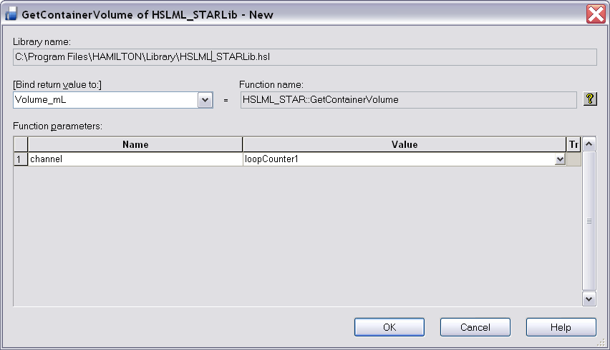
Get Container Volume
Use the [Bind return value to] field to create a variable for the volume that is returned.

Slide 12
Get Container Volume
Don’t forget to convert the returned volume from ml to ul, depending on what you need to do with that volume data.

Slide 13
Get Container Volume
Be aware:
If you are using these commands with variable channel pattern, the last liquid level or volume measured is retained in memory.
Don’t make a mistake. You may need to refresh your variables (reset your volumes to zero) to make sure you don’t get erroneous results.

Slide 14
Troubleshooting
If you find the calculated volumes don’t seem accurate:
Verify position of bottom of container (use probe to check z=0)
Adjust container definition
Check submerge depth

